Slide 1
Opioid Observation and Treatment Centers (OOTC)
Notes:
Hi there, we are Hasa and Olivia here to present our harm reduction strategy program for Mesa Arizona to reduce opioid related deaths. Opioid Observation and Treatment Center (OOTC) are safe spaces with support from staff and resources prepared for emergency response and a corresponding webapp to visualize and predict areas prone to overdosages and best locations for OOTCs

Slide 2
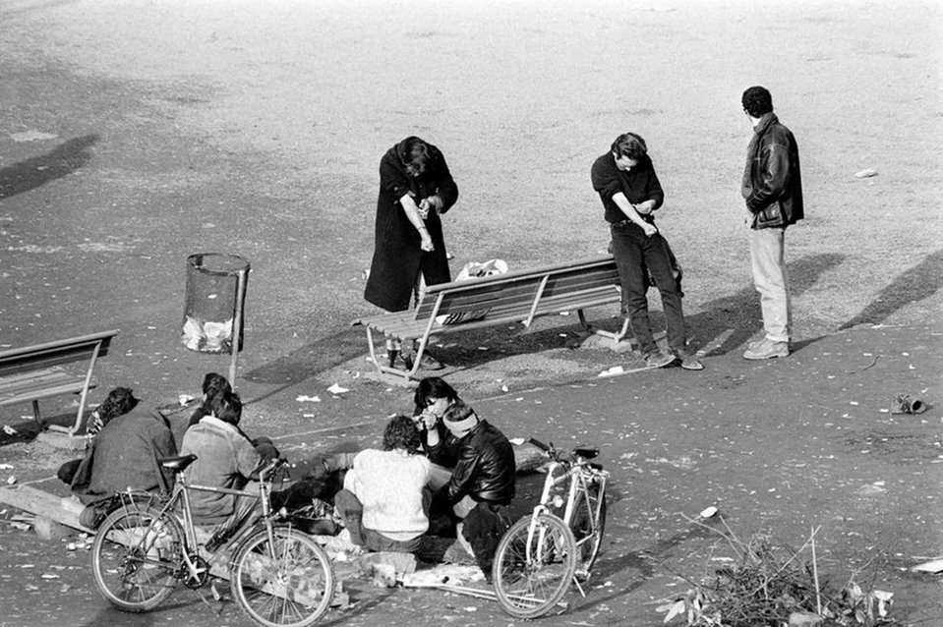

Harm reduction strategy
Platzspitz or the 'Needle Park', June 1990​
Notes:
The concept of ‘harm reduction’ refers to a set of policies, programs that aim to reduce the health, social, and economic consequences of drug and alcohol abuse. During the 1990’s opioid crisis in Switzerland safe spaces for heroin usage were introduced as part of the 4-pillar drug policy which helped reduce overdosage deaths by 64%.

Slide 3
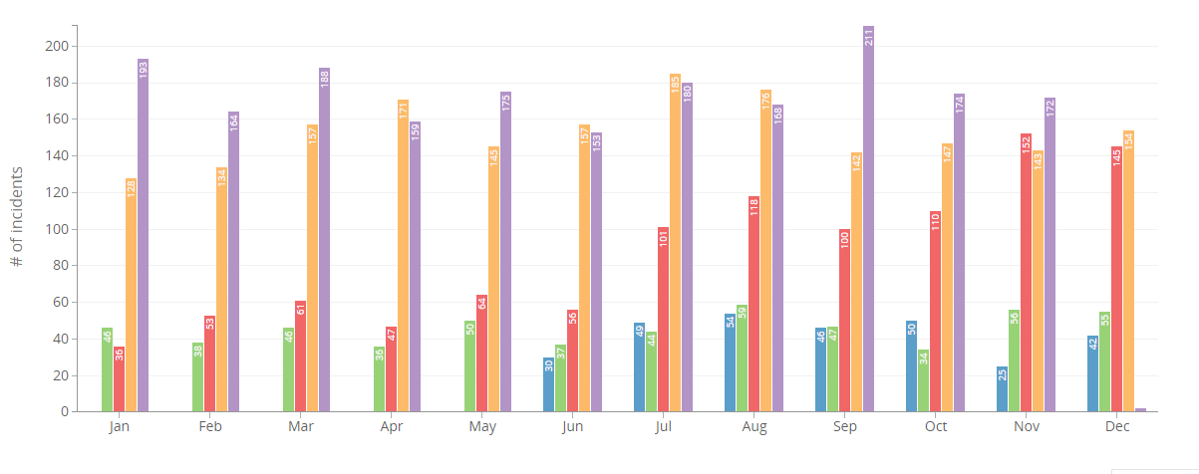
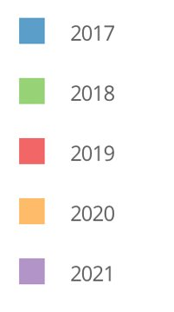
Mesa
MESA COUNTY OPIOID RESPONSE GROUP
Prevent substance misuse
Improve treatment access & retention
Reduce harm
Opioid cases over the years in Mesa.
Notes:
The misuse of and addiction to opioids—including prescription pain relievers—is a national crisis. In 2020, opioid overdose incidents in Mesa increased by 76%. Mesa County Opioid Response Group was established to identify strategies to address the crisis. With goals to Prevent substance misuse, improve treatment access and reduce harm. We envision our strategy to be incorporated into their harm reduction goal.

Slide 4
Our Use Case And Users
Create a user-friendly web application accessible to healthcare officials that visualizes and describes the best locations for potential Opioid Observation and Treatment Centers (OOTC)
Policy makers
City healthcare officials
Notes:
Our use case is to establishing safe spaces that provides support, safe and monitored injection sites, overdose treatment, and primary care for heroin users who would be otherwise be on the street. And a user-friendly web app that visualizes urgency and to predict best locations for OOTCs along with resource allocation to mitigate opioid overdose death.

Slide 5
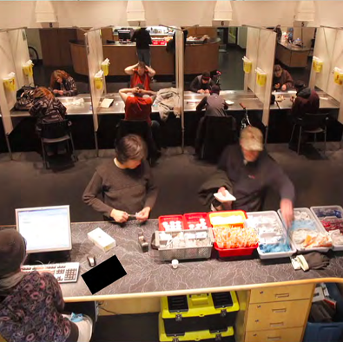
New York City Is Funding America's First Official Safe Injection Site for Drug Users
Notes:
Coincidentally, just after we started our proposal, New York city rolled out first ever government-approved supervised drug injection site. NYC mayor according to a leading new paper acknowledges that Overdose prevention centers are effective way to address the opioid crisis.” which reinforces our proposal for Mesa.

Slide 6
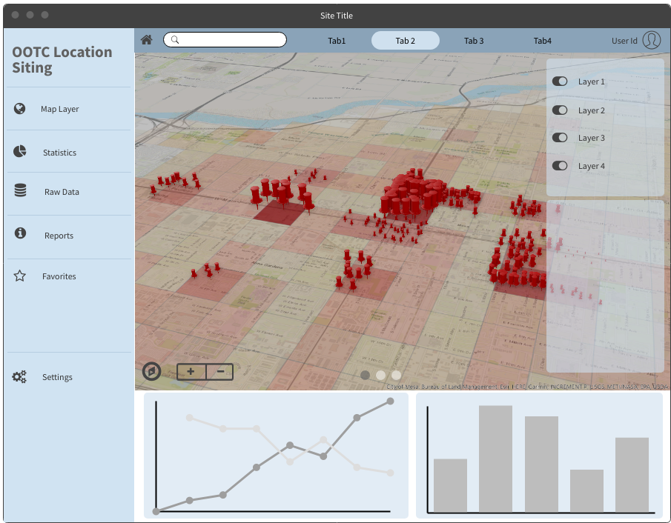
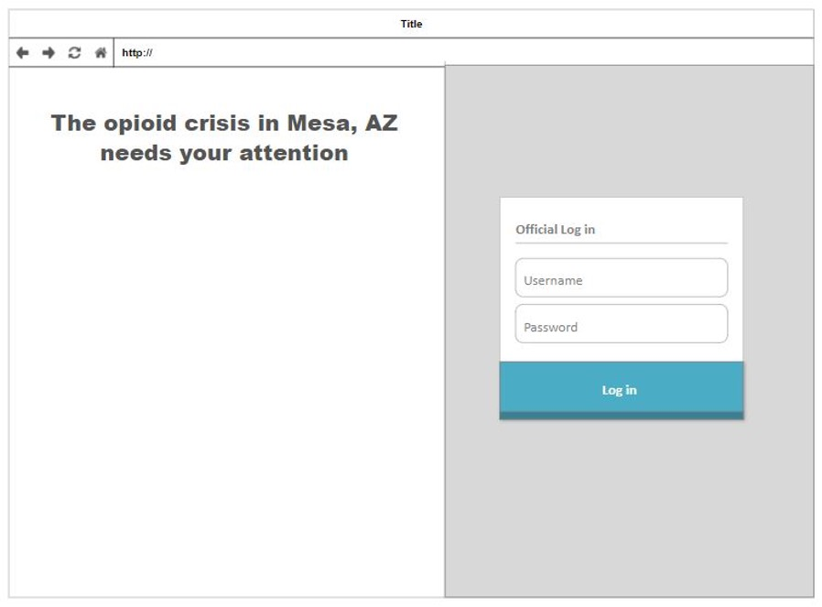
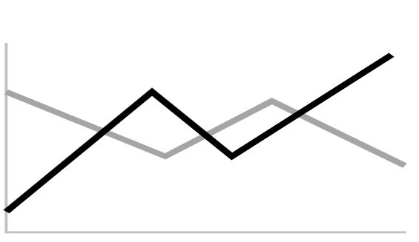

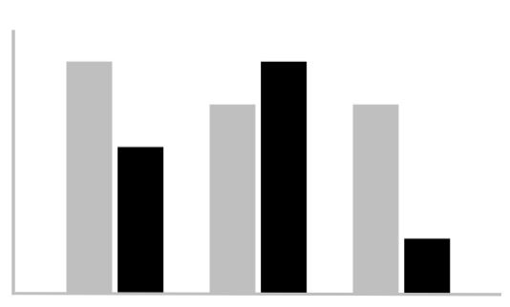

Wireframe
Wireframe
Landing Page
Landing page
Public portal
Health officials log in
Resources
Notes:
Moving on to the wireframe of our app, this would be the landing page. We envision this app being used both by the public and health officials/ stakeholders. With all the information on programs and other recourses the left side of the screen for friends, family to help their loves ones. On the right is the log in page for officials to access the predictive maps, analysis charts etc.

Slide 7
Wireframe
Predictive maps
Notes:
Once we log in, we will have various tabs for various predictors to, for eg see opioid crisis predicted hotspot, observed opioid overdose events and predicted with Other layers that may be useful can be toggled on and off. This will help health officials decide where to administer service sights.

Slide 8
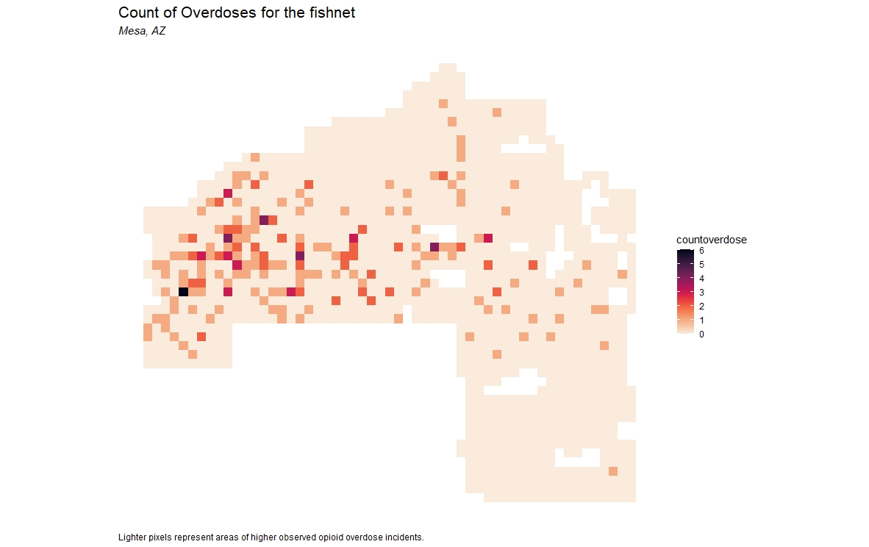
Variables
Fishnet
Count of overdoses for the fishnet
Fire and Medical Opioid Overdose Incidents
Census ACS data
City Property Data
Crime Data
Park Locations And Amenities
Light Rail Stations
City Boundary Map
Zoning Districs
Fishnet - illustrates opioid overdose incidents from 2017, where darker pixels indicate a higher count of incidents.
Notes:
Let’s understand how these predictive maps are made. We start of by using variables like crime, proximity to city facilities & and demographic to predict overdoses as a function of environmental factors. To analyze the risk of opioid overdose evenly across space we create a ‘fishnet’ at 1/3 mi dimensions, to which we will aggregate point data.

Slide 9
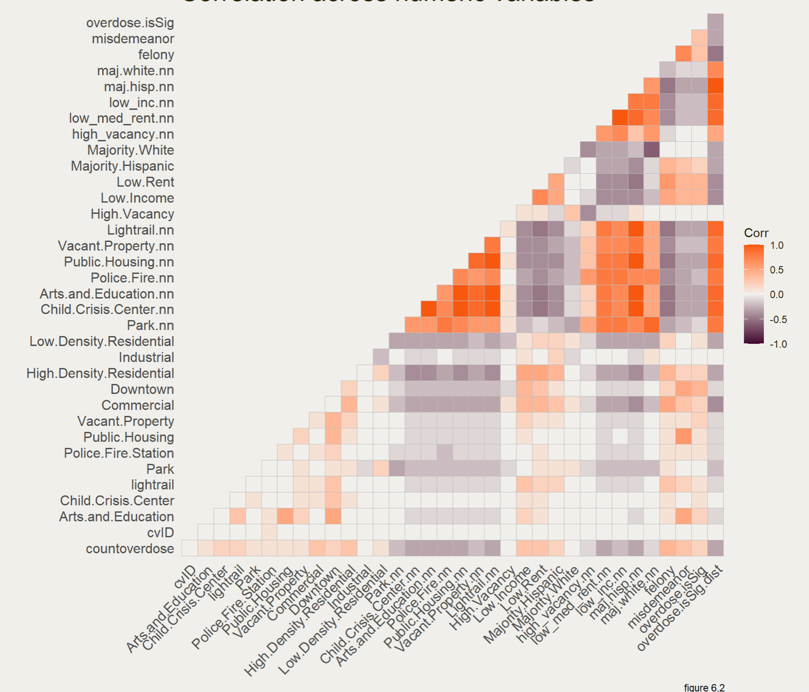
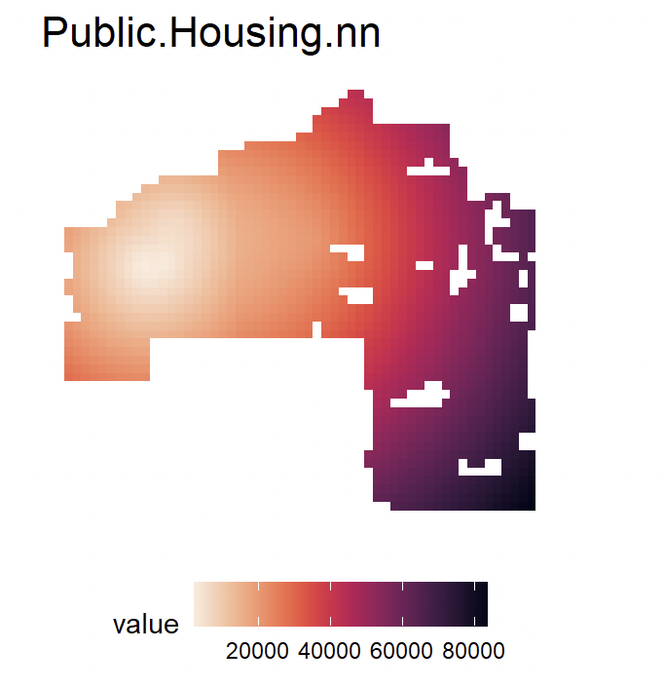
Most importantly to be very sure that our model predicts better than traditional overdosage hotspots, we check whether risk predictions outperform traditional ‘Kernel density’ hotspot mapping. To add an element of across-time generalizability, hotspot, and risk predictions from 2017 overdosages are used to predict the location of 2018 overdosages.
Nearest neighbour Correlation coefficient
Nearest neighbor function used on our City property and census data
Notes:
The nearest neighbor function calculates the average distance of each fishnet cell to the closest 3 points of the variable. Last step of the exploratory analysis, To determine whether to use the unaggregated or nearest neighbor variables we analyse the correlation of each independent variable to the dependent variable.

Slide 10
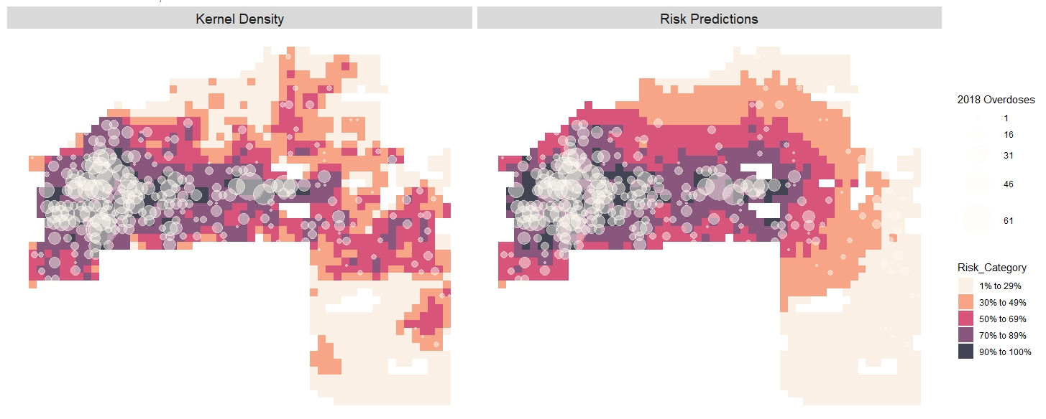
Comparison of Kernel Density and Risk Predictions
2017 Overdose Risk Predictions; 2018 Overdose
Notes:
Most importantly to be very sure that our model predicts better than traditional overdosage hotspots, we check whether risk predictions outperform traditional ‘Kernel density’ hotspot mapping. To add an element of across-time generalizability, hotspot, and risk predictions from 2017 overdosages are used to predict the location of 2018 overdosages.

Slide 11
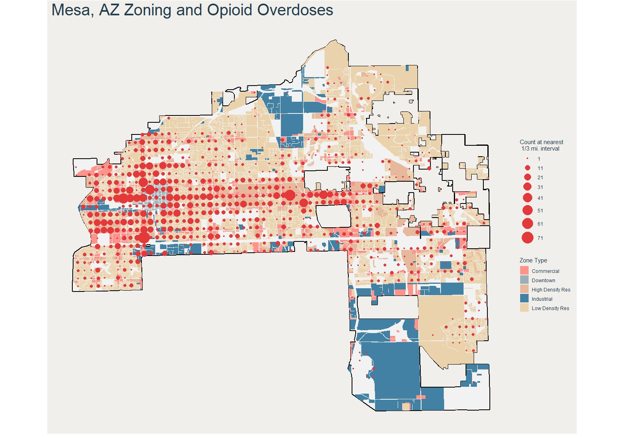
Inclusivity
Notes:
To round off the positioning of OOTCs in the predictive analysis, predominately in nonresidential zones. We recognize that overdosages do happen at residents and OOTCs would be equipped with health officials and other necessary resources, such as ambulances required for offsite cases as well.

Slide 12
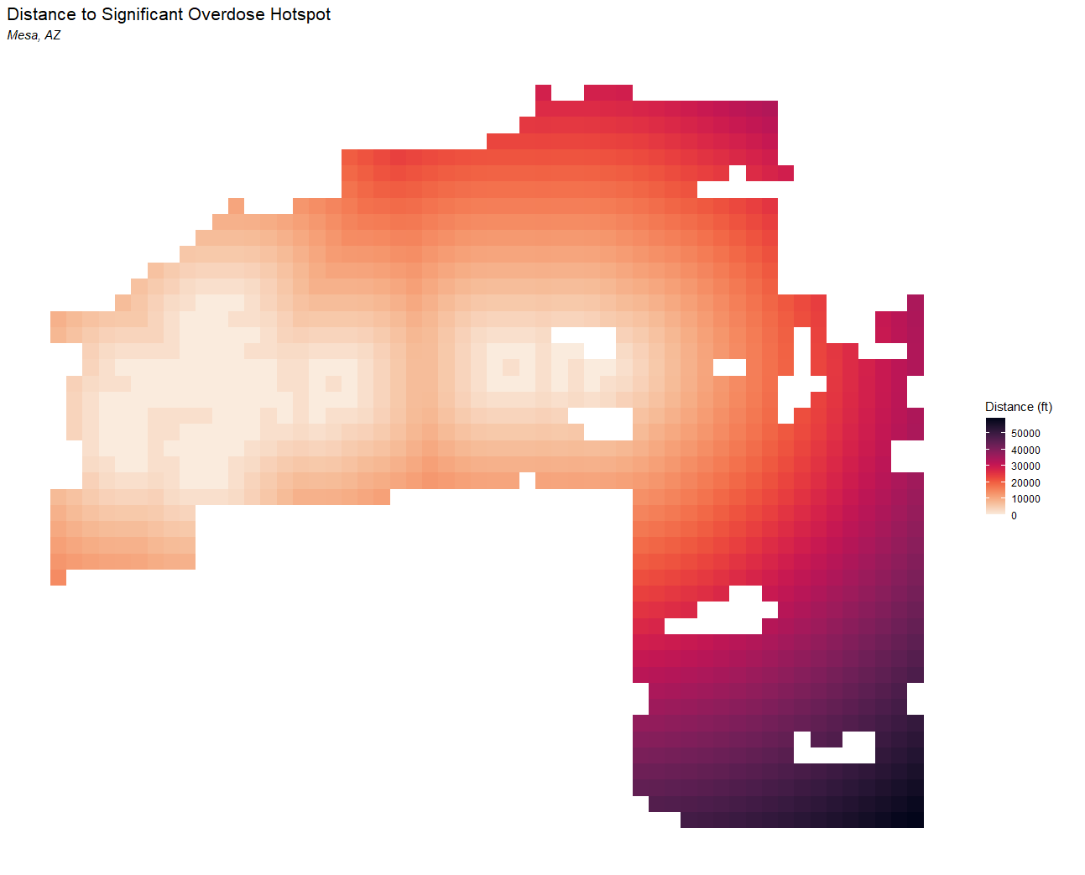
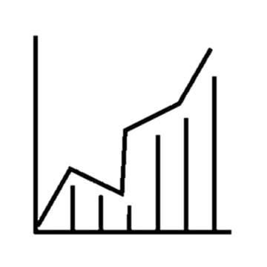
Wireframe
Fire Police and ambulance dispatch
Inventory
Notes:
Concluding with other features on the webapp we will be able predict future OOTC sites, analysis the most and least used sites, sites that are overwhelmingly being used, resources can be reallocated accordingly. The app it would also include the inventory of the resources at various sites.

